Slide 13
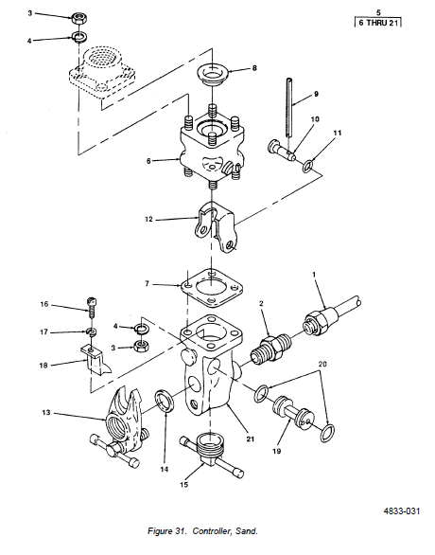

Slide 44
CONTROL AIR

Slide 48
